Slide 1
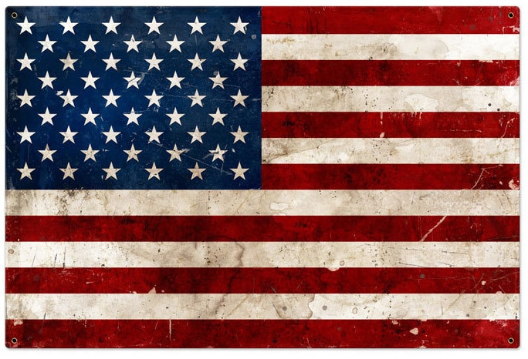
KNOCK THE RUST OFF
16th ANNUAL JBER MOTORCYCLE RIDE
Experienced Motorcycle Mentorship + Alaska Riding Familiarization PPE Inspection + Motorcycle Inspection
REGISTRATION @ 0800
Friday, May 30
START: JBER-R MSF Pad FINISH: Denali Harley Davidson
Riders Must Have: License, Registration, and MSF Card All mandated PPE A Full Tank of Gas $5 for Lunch in Wasilla
A Special Thank You to: The JBER Green Knights MMC
Denali Harley-Davidson (Wasilla)
PRIMARY POCs:
KTRO RIDE: Green Knights Alaska Email: Greenknightsak@gmail.com | 673 ABW Safety: TSgt Haymaker Email: benjamin.haymaker@us.af.mil

