Slide 1
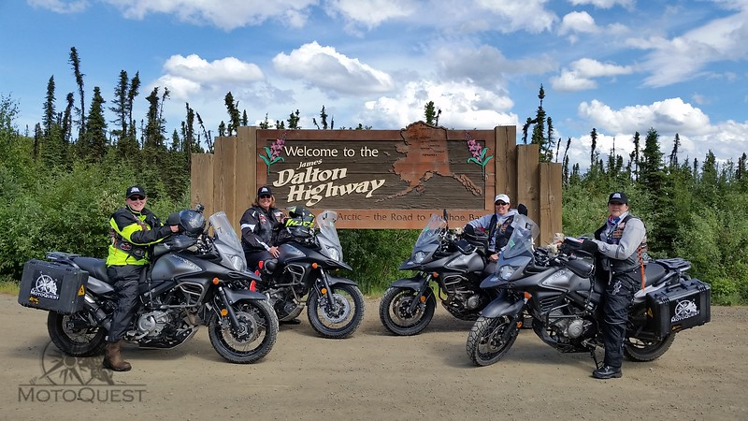
2025 Preseason
Motorcycle Brief
JBER Installation Safety Office
552-6850

Slide 2
Commander Comments
“Ride responsibly and within your limits! Always wear your PPE, and remember we provide motorcycle training that meets the DoD requirements.”

Slide 3
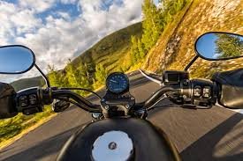
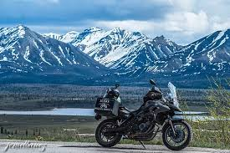
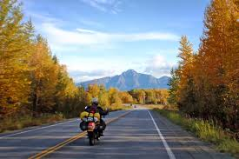
Agenda
References
Mishap Stats
2025 Goals
Riding Season
Training Requirements
Training Requests
2025 Focus
Year of the swerve
PPE
Emergency Gear
T-CLOCS
Local Riding
Risk Management
KTRO

Slide 4
References
DoDI 6055.4, Chapter 4 – DoD Traffic Safety Program
27 August 2021 published
DAFI 91-207, Chapter 4 – USAF Traffic Safety Program
Certified Current 9 Jan 2024
AR 385-10, Chapters 11-7 & 11-9 – Army Safety Program
24 March 2017
JBER-57 – Commander’s Letter on Motorcycle Safety
Notes:
DoDI 6055.04 Updates include
Motorcycle Operator Training Section 2, table 2.
Motorcycle Operator PPE: Section 2, para. 3.3., d.
AFI 91-207 Updates
PPE and Training requirements updated to DoDI 6055.04

Slide 5
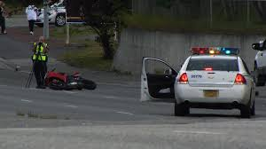
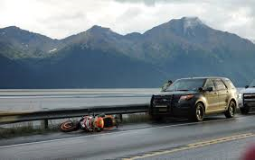
Motorcycle Mishaps
No AF/Army motorcycle fatalities associated with JBER in FY24.
DAF FY20-FY24
(76 fatal, 5 PTD, 10 PPD, 741 LT)
18,370 Lost Work Days, $800 Million in mishap costs)
FY23 Army 38 Fatalities
FY24 Army 34 Fatalities
Primary Mishap causes:
Speed
PMV4 turning left
Behavior
“Intoxication Substances”
Notes:
Speed
- 19 operating sport bikes
- 18 Speeding
- 16 in excess of 25mph over limit
- 13 had incomplete or unknown training
- 12 Between 20-25 yrs old
- 10 not registered
- 7 Failed to negotiate a curve
- 7 involved intoxication
Sources: Army and Air Safety Centers
safety.army.mil
safety.af.mil

Slide 6
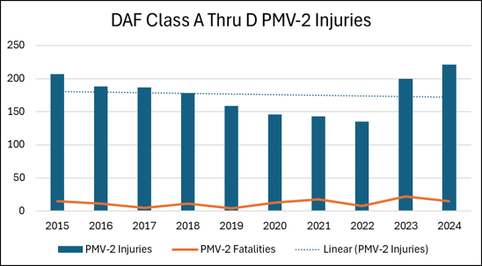
Mishap Statistics
Steady mishap decline since 2014 to 2022
48% Spike FY23 10% increase in FY24
35% PMV-2 mishap decrease between
2014 & 2022
Prevention efforts only work with
leadership involvement
The difference between a minor mishap
and a fatality is often only a small thing
like sand on a corner or a curb being
hit vs. a smooth shoulder

Slide 7
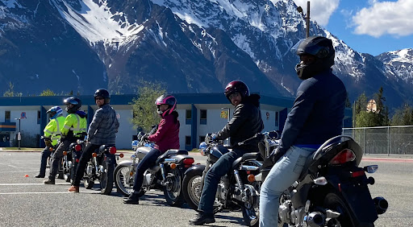
2025 Rider Kickoff Goals
Rider commitment:
100% Trained, Prepared, and Equipped…ALWAYS
100% Contact with ALL unit riders
CC/MSRs/UMMs contact all unit riders for riding status
100% Trained or scheduled for ALL unit riders
CC/MSRs/UMMs verify all unit rider’s training status/schedule any needed training
100% Unit/section sweep for any unregistered riders
CC/MSRs/UMMs to verify no unregistered riders in unit & schedule training as needed
100% MUSTT update for ALL unit riders (AF ONLY)
CC/MSR’s/Unit Riders verify status and records of all unit riders in MUSTT
Notes:
673 MSG Commander determines when road conditions go green for on base riding.

Slide 8
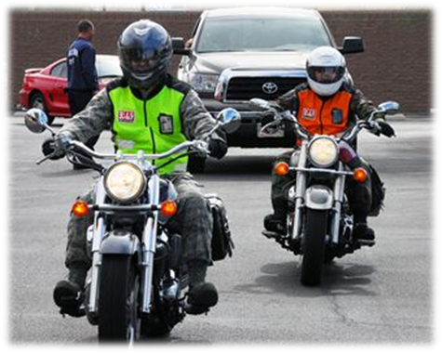
Riding Season
For Updates:
Call 552-INFO (4636);
JBER Social Media
JBER CONNECT APP
https://www.jber.jb.mil/
On-Base:
Riding on-base authorized only when road conditions are “GREEN”
Installation leadership may adjust based on road conditions and/or weather
Off-Base:
Riders must use sound judgement and common sense when determining if road conditions are safe for riding
Notes:
673 MSG Commander determines when road conditions go green for on base riding.

Slide 9
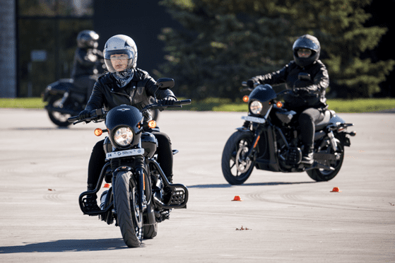
Training Requirements
Who MUST receive Motorcycle Safety Training?
Uniformed Service members who ride on and off base
License (or permit prior to course)
License = Level I training complete
Level I training (BRC or equivalent) = Level 1 training complete
MUSTT Update
Required annually AND after training is complete
Continuation training (Level II)
Within 6-months, not to exceed 1-year
Sustainment training (Level III)
At least every 5-years
Notes:
Reference: DoDI 6055.04 (4)(f); AFI 91-207 para 4.4.2.; AR 385-10 Ch 11-7 (a)(5)

Slide 10
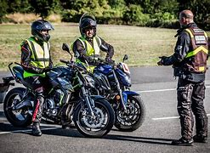
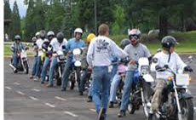
Training Requirements
Motorcycle Safety Training
JBER Voucher process will cover cost of rider training for members in a Federal Status (Title 10) through the approved contractor.
Rider has 10 calendar days from the voucher approval date to schedule class or authorization is void
Must complete e-course requirement to receive completion card
No reimbursements if you attend training with the contractor or different vendor without an approved voucher
Notes:
Reference: DoDI 6055.04 (4)(f); AFI 91-207 para 4.4.2.; AR 385-10 Ch 11-7 (a)(5)
Courses can be completed anywhere as long as it is a service approved course. Contact the Installation Safety Office for a suitable substitute.

Slide 11
Training Requests
Training is contracted out by the 673 ABW to a local vendor
House of Harley Davidson (HD), Anchorage and Denali HD, Wasilla
https://www.harleyalaska.com/--learn-to-ride
Members seeking training must complete the 2025 JBER Motorcycle Safety Training Request PRIOR TO SCHEDULING TRAINING
The form is available on/from:
JBER Safety SharePoint: https://intelshare.intelink.gov/sites/jointbaseelmendorfrichardson/SE/_layouts/15/start.aspx#/SitePages/Home.aspx
Unit MSR/UMM
JBER PA Website – https://www.jber.jb.mil
Click the “What’s Hot” tab and JBER Motorcycle Safety
Complete the 2025 form with all signatures and email to JBER Safety 673abw.seg@us.af.mil or bring to building 10441 3rd floor
Once approved follow directions on the form to schedule training
Notes:
Reference: JBER-57 Installation Commander’s Letter on Motorcycle Safety
Training contracted through Alaska House of Harley Davidson: https://www.harleyalaska.com

Slide 12
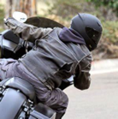
Training Requests
Please use your vouchers!
“By signing below, I have read and meet the intent to ride per the Installation Commander's Letter on Motorcycle Safety (JBER-57) and understand that I am obligated to complete the course once I receive a voucher and schedule training. If I fail to reschedule or cancel with the contractor at least 48 hours prior to the report date, I will be responsible for the cost of the training.”

Slide 13
PMV-2 Focus 2025
Skill Building
Training – Get caught up and stay trained
Advanced training (track, ADV, etc.) – Invest in your own riding!
Practice EVERYTIME you ride!
Braking, tight circles, and cornering – warms your tires and your skills!
Ride within YOUR skill level – Don’t push it
Personal Accountability
Practice before you ride
NEVER drink and ride
SLOW DOWN! Where do you have to be? Is it worth your life?
Ride within YOUR skill level – Don’t push it
Wear as much gear as you can…ALWAYS!
MUSTT (AF Only) / MMP (Army Only)
Log training
Log briefings
Get records Up-to-Date for all in unit
Ensure information accuracy
Motorcycle information current?
Notes:
673 MSG Commander determines when road conditions go green for on base riding.

Slide 14
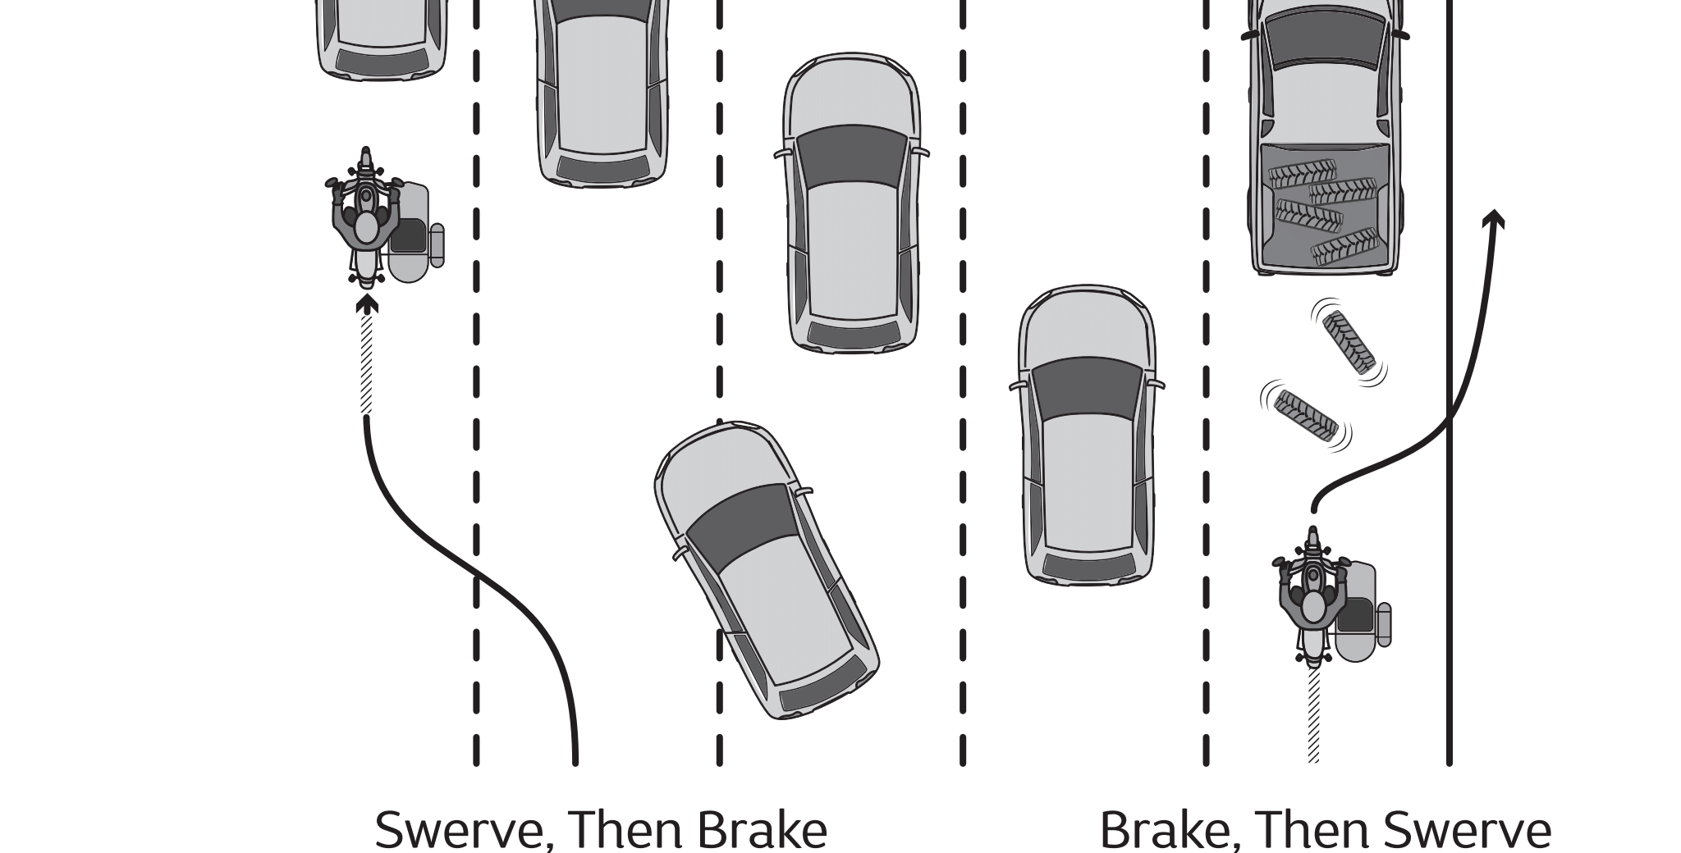
Year of the Swerve
Steps of a good Swerve
Always be looking for escape paths
Use counter steering to conduct the swerve
Keep your body upright during swerving
DO NOT BREAK DURING THE SWERVE
If you must break, break before or after conducting a swerve
Learning to Swerve
Training – BRC-1 Covers the basics
Practice makes perfect
Take the time to be comfortable swerving
Practice in a parking lot, or controlled area
Ask a mentor for help

Slide 15
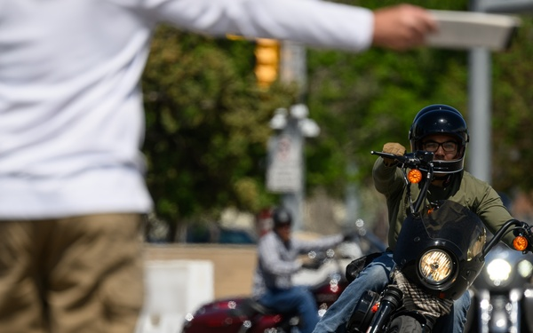
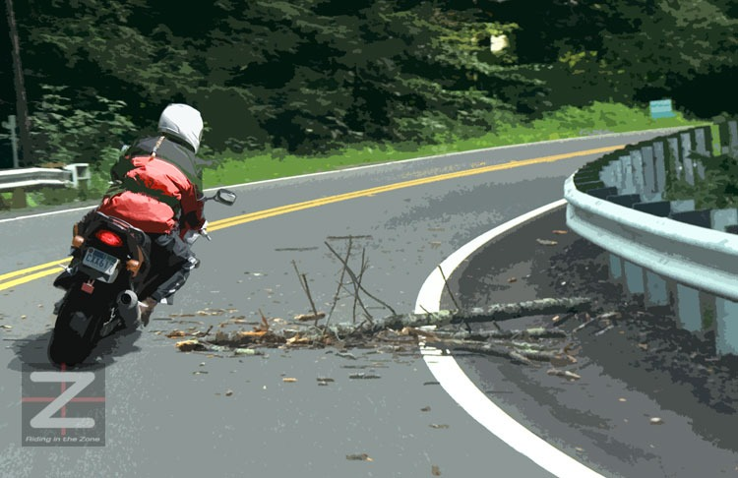
Year of the Swerve
Why do I need to know how to Swerve?
Swerving can help you avoid obstacles quickly
Learning proper swerve techniques creates a better understanding of counter steering
Understanding counter steering increases Skill level
A correctly executed Swerve can save your life!

Slide 16
MUSTT / MMP
Air Force
Review MUSTT record at least annually (Annual/Preseason)
Log in at: https://afsas.safety.af.mil/my.policy
On-Street Motorcycle Riders – required to have record in MUSTT
All required briefings and training tracked via MUSTT
Army
Unit Safety Officers / Motorcycle Mentors will maintain a unit motorcycle roster of all unit motorcycle riders
Roster will include: license number, initial training date and next required continuation training dates
Units will maintain written copies of their respective MMPs. MMPs may be inspected as part of OIP inspections
Information for establishing the unit MMP is available at https://safety.army.mil/MMP/
Notes:
Used as management tools on future guidance and funding
Request for training & briefing credit accomplished through MUSTT, approved by MSR
Motorcycle Unit Safety Tracking Tool (MUSTT)

Slide 17
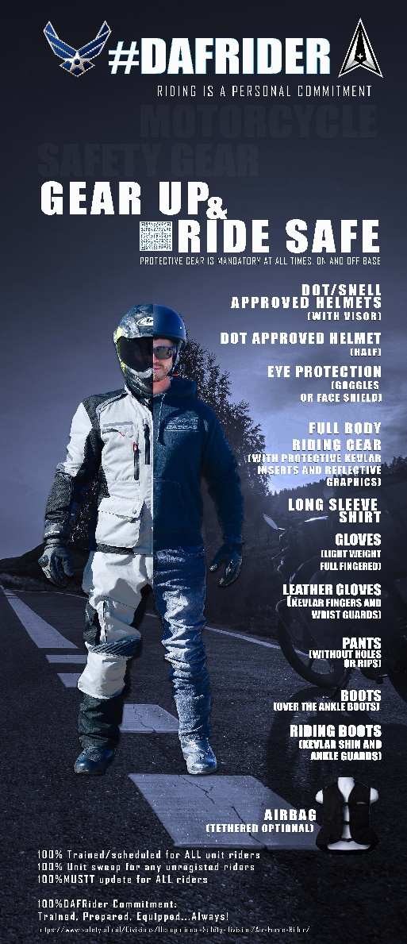
Required PPE
Helmet DOT/SNELL/ECE Approved: Required
Eye Protection: Required
Gloves, Full-fingered: Required
Long Sleeve Upper Outer Garment: Required
Long Pants: Required
Highly Visible Upper Outer Garment: Not mandatory but is highly recommended
Airbag Vest: Not mandatory but is highly recommended
Notes:
673 MSG Commander determines when road conditions go green for on base riding.

Slide 18
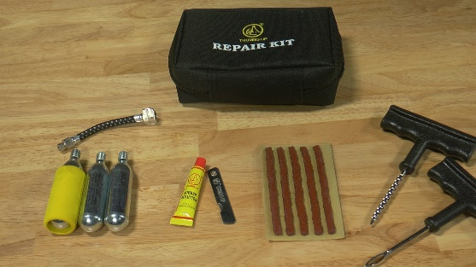
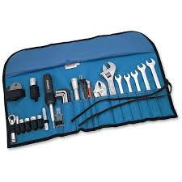
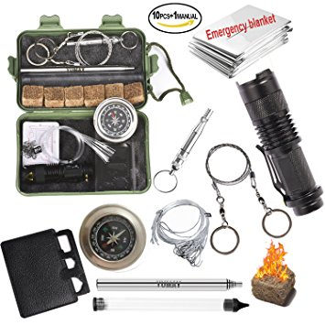
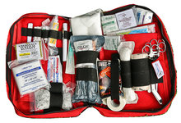
Emergency Gear
Here are some suggested items to carry with you if there is space to do so safely:
Phone with charger
Tire Repair Equipment
Tools
Cold Weather Gear
First-Aid Kit
Wet Weather Gear
Flashlight
Cash
Notes:
Be mindful of areas without cellphone service availability.
Weather could become a factor while out riding. Do you have the right gear?

Slide 19
T-CLOCS Inspection
Designed by the Motorcycle Safety Foundation (MSF):
Scope of the inspection can be tailored to the situation
Longer and more in-depth for preseason or pre-purchase inspection
Shorter and hitting key elements for day to day use
https://www.msf-usa.org/wp-content/uploads/2022/06/T-CLOCS_Inspection_Checklist.pdf
Notes:
AFSEC motorcycle safety videos with Dr. Love
https://www.dvidshub.net/video/600433/t-clocs

Slide 20
Alaska Licensing
How do I get my Alaska Motorcycle License?
You must go your local DMV office to apply for an original driver license or motorcycle license. You will submit form D1, which can be filled out and printed in advance.
Please note:
Alaska law requires a DMV road test or an approved motorcycle class to get a motorcycle license.
Alaska law also requires a written motorcycle knowledge test
https://doa.alaska.gov/dmv/akol/motor.htm
Out of state licenses will need to be coordinated
with the applicable State DMV (if possible)

Slide 21
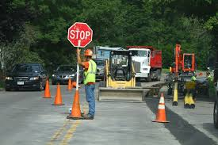
Local Riding Tidbits
Alaska has two distinct seasons, winter and construction
Riders can expect weather and temp changes throughout the riding season
Quality protective gear will provide comfort in all conditions and help avoid distractions by adverse weather
Weather & road conditions: 511.alaska.gov or weather.gov
Notes:
During the Construction season it is not uncommon to see loose rocks, gravel, sand and other construction debris and tools on the highway, residential streets and parking lots.
Road crews are usually out as soon as the thaw starts so keep an eye for them especially going around blind curves.

Slide 22
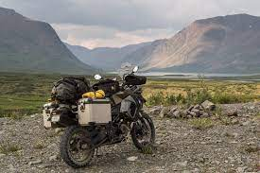
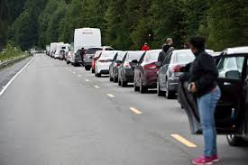
Local Riding Tidbits
Tourism increases in the state during the riding season
Plan for additional traffic that may conduct frequent stops and/or drive at inconsistent speeds
Expect delays, debris, and uneven pavement in construction areas
Notes:
Areas of interest and common traffic and tourist buildup:
Seward Hwy: Girdwood to Seward and Bridge near Whittier turnoff
Richardson and Parks Hwy: Talkeetna, Denali National Park, Hurricane Gulch Bridge and Susitna River Bridge
Tourists: Distracted drivers and pedestrians

Slide 23
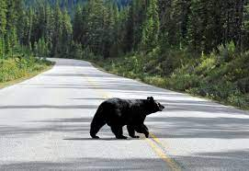
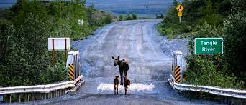
Local Riding Tidbits
Wildlife do not know the meaning “right of way” and may unexpectedly cross roadways.
Be vigilant in high wildlife areas, reduce speed and give them space to move.
Notes:
Report potholes on base by calling 552-2994 or 2995

Slide 24
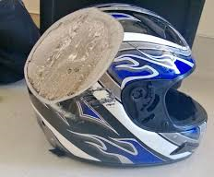
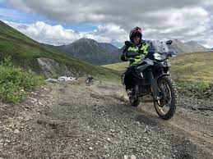
Risk Management
Make sure there is fuel available along your route
Ride rested and unimpaired
Carry emergency gear
Ensure you have/wear the correct PPE
Know your limits
Have a trip plan and share it
Carry rain/cold weather gear
Check weather and road conditions
Notes:
Plan your route, know were all the fuel spots are and the distances between them. If you don’t already have one, you may even what to pickup a copy of the Milepost and use it to help plan your route. Phone numbers to some of the gas station/convenience stores call found in it, call ahead to see if they are ever open for business yet. Some of the mom & pop stores do not open until late May early June and are closed by the end of September.
The longer hours of daylight will most likely disrupt your sleep cycle for a few weeks to a month, not to mention inevitably someone in your neighborhood will lose track of what time it is and start mowing there lawn at 10 o'clock at night.
When group riding leave your self enough room between you and the bike in front of you, this allows you more time to see and take appropriate measures to avoid hazards.
Reference: AFI 90-802 & AFI 91-207 para 3.4.3.

Slide 25
Pre-Season Briefing
2025 Knock The Rust Off Ride
16th Annual Knock The Rust Off Ride:
Where?
TBD
When?
TBD
All day event intended for riders to hone riding skills for the Riding Season
What?
Meets DAFI 91-207 mentorship requirement
Bike inspection (T-CLOCS)
Bike Blessing
Voluntary rider drills
Camaraderie for JB riders

Slide 26
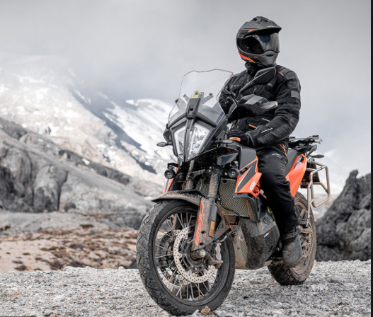
Questions?
Contact JBER Safety at DSN 552-6850 or email 673abw.seg@us.af.mil for questions or concerns
SPRING PMV-2 FOCUS

