Slide 1



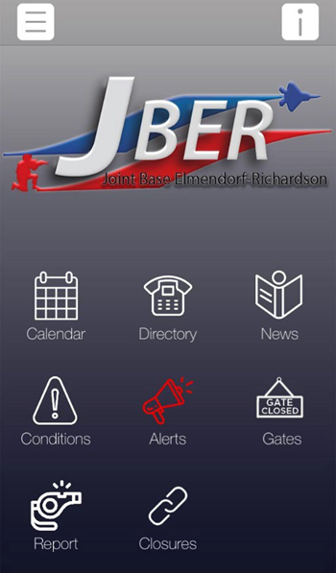
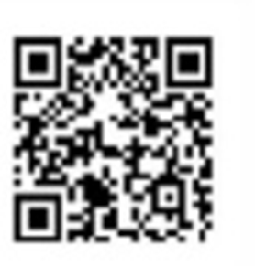
Joint Base Elmendorf-Richardson
Home of America’s Arctic Warriors
Use this time to download the JBER Connect App.
This is how the Installation communicates with you.

Slide 2
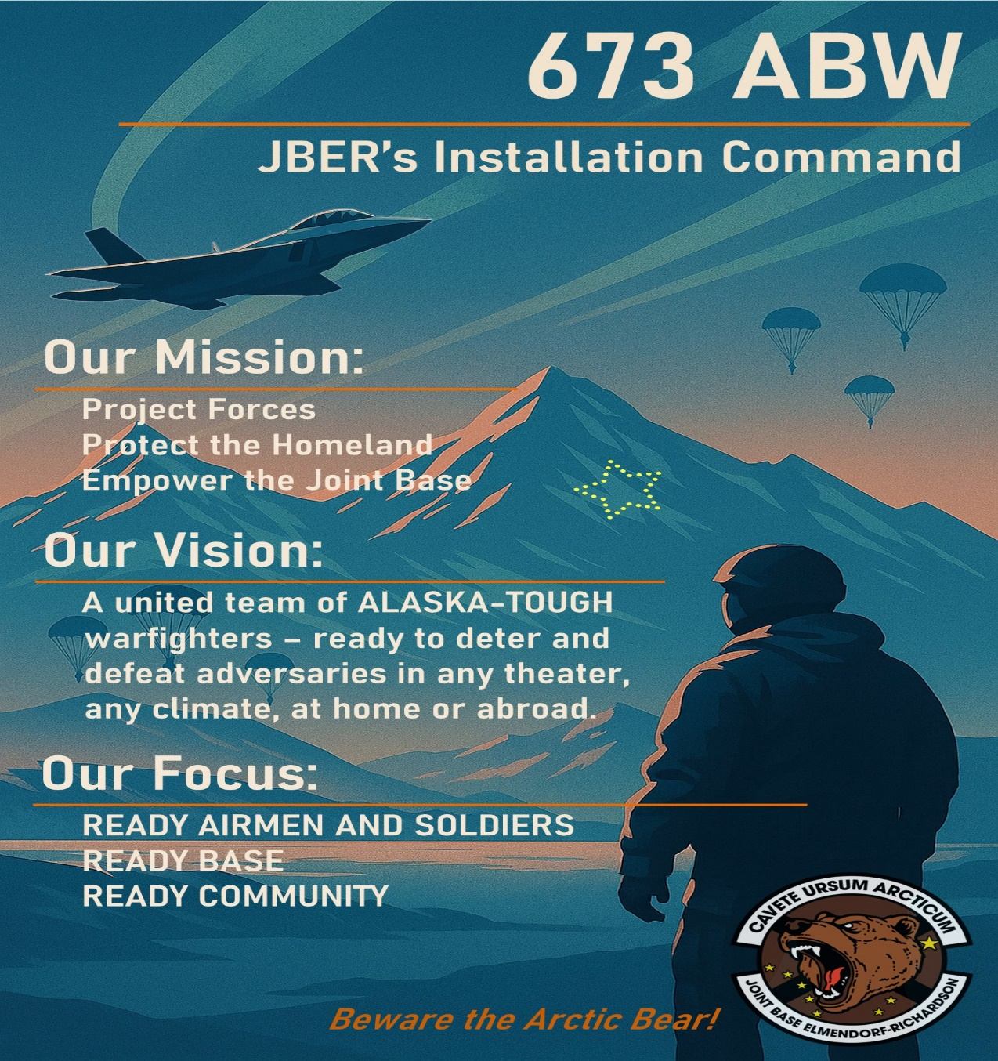
Joint Base Elmendorf-Richardson

Slide 3
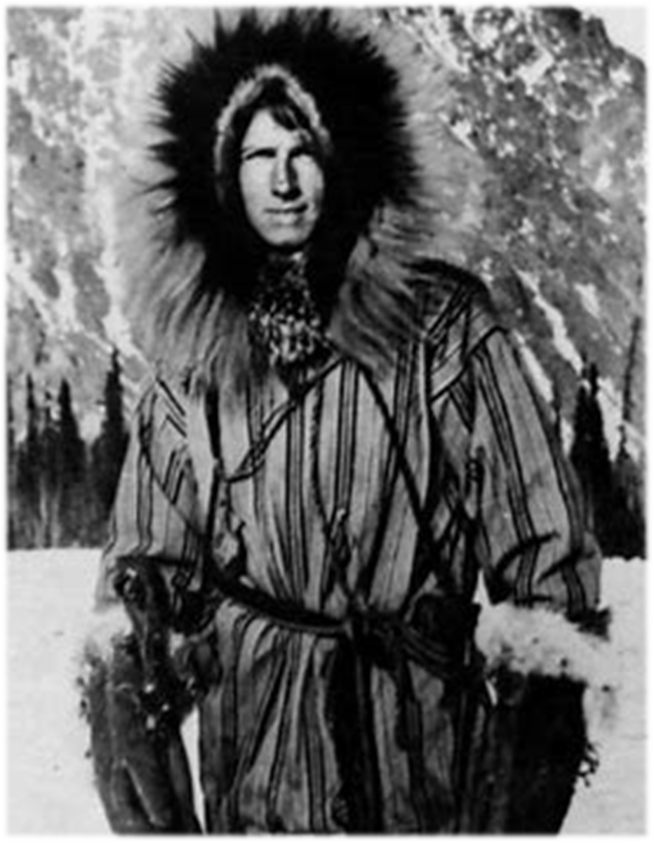
Strategic Significance
Home of America’s Arctic Warriors
“Alaska is the most central place in the world … and that is true either of Europe, Asia or North America. I believe in the future, that he who holds Alaska will hold the world, and I think it is the most important strategic place in the world”
-- Brigadier General Billy Mitchell – Feb 1935
Agile Arctic Combat Support

Slide 4
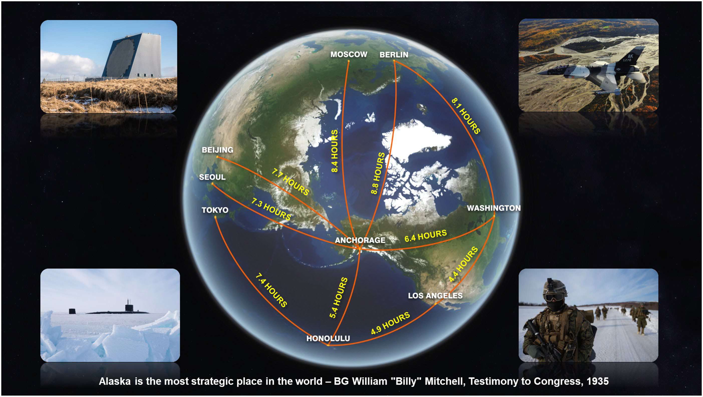










Alaska’s Strategic Location
Agile Arctic Combat Support

Slide 5
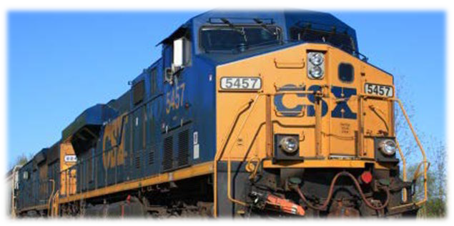
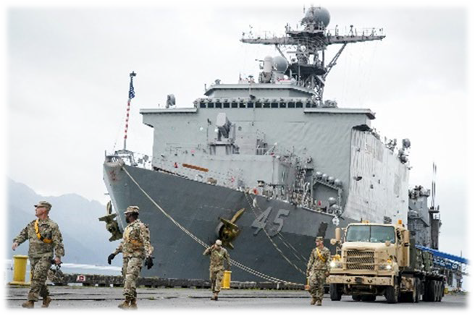
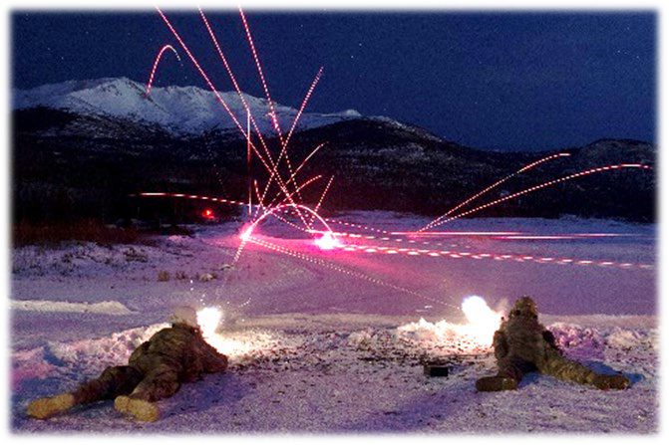
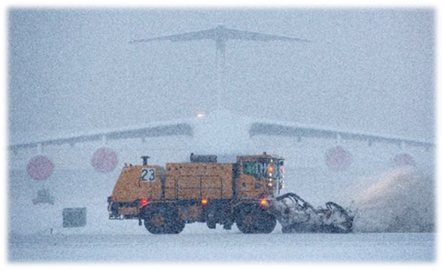
Key JBER Attributes
Joint Operations
World Class Drop Zones & Live Fire Ranges
Four Airfields
Deep Water Port
Alaska Railway
Key Logistics Hub
Arctic Access
Global Reach Capability
Agile Arctic Combat Support

Slide 6








Joint Base Structure
11th AIRBORNE DIVISION
U.S. ARMY ALASKA
ALASKA COMMAND ALASKA NORAD REGION 11TH AIR FORCE
1/11 IBCT
(AASLT)
2/11 IBCT (ABN)
17TH CSSB
673d
Air Base Wing
3d Wing
FWA
JBER
JBER/FWA
3d Operations Group |  |  | 3d Maintenance Group
1-501ST PIR ABN
3-509TH
PIR ABN
6TH
BEB ABN
1-40TH
CAV ABN
2-377TH
PFAR ABN
725TH
BSB ABN
673d Logistics
Readiness Group
673d Medical
Group
673d Civil
Engineering Group
673d Mission
Support Group
JBER Army Sustainment Element
Your Garrison Support Team!

Slide 7
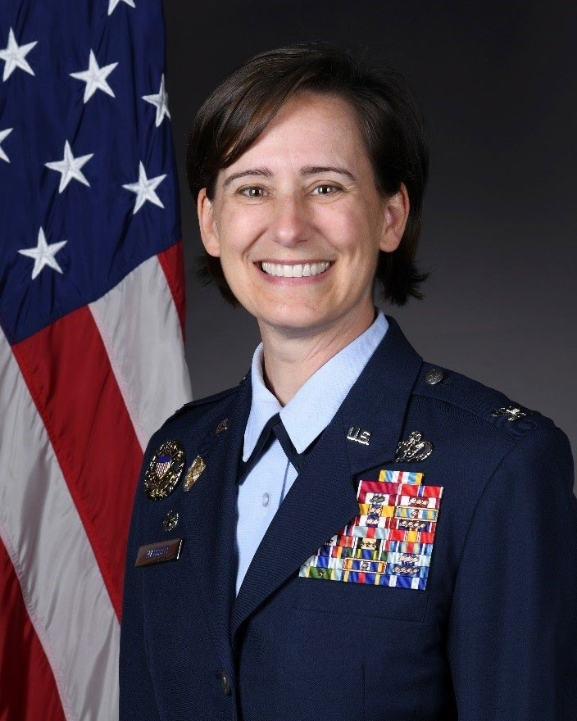
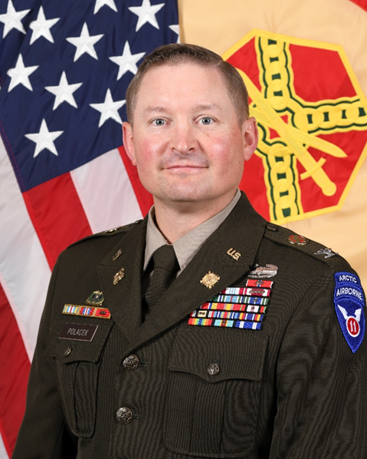
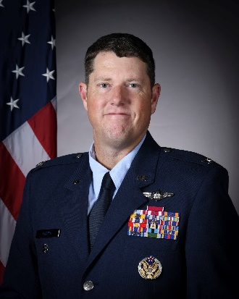
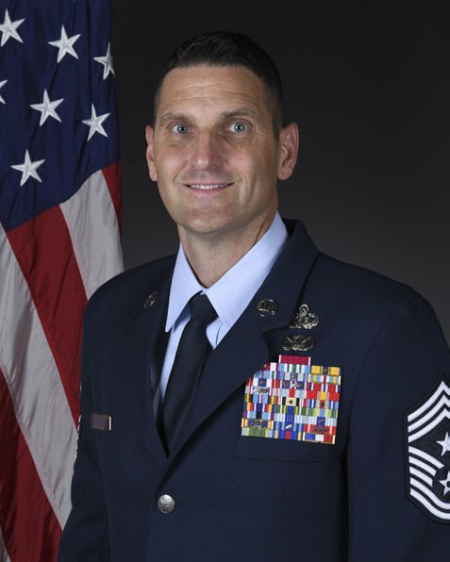
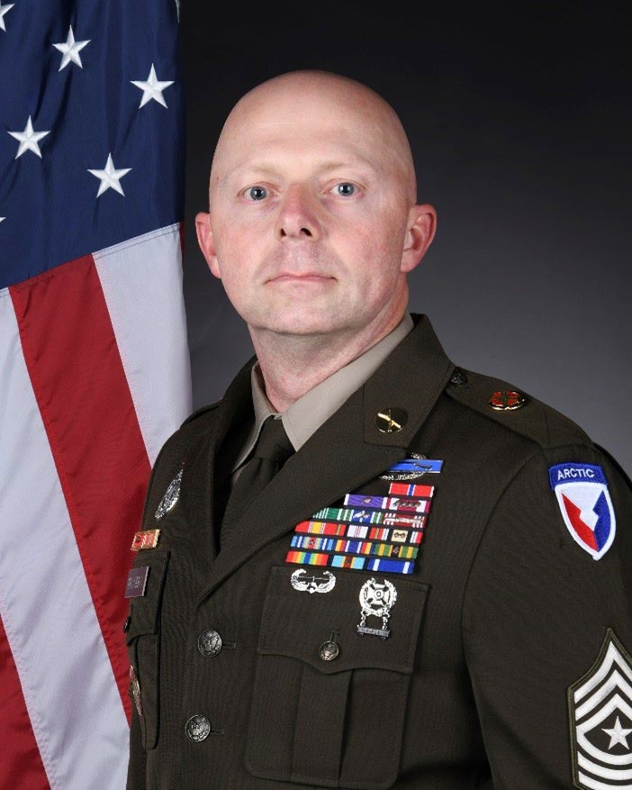
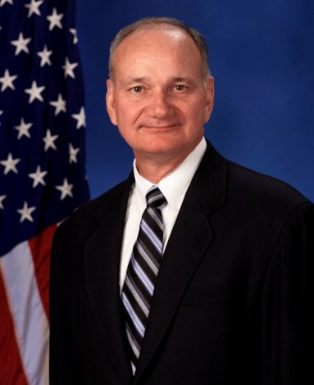








































Col Lisa M. Mabbutt Commander
COL Stephen Polacek
Deputy Commander
Col Troy Pierce
Deputy Commander
CMSgt Michael Sylvester Command Chief Master Sergeant
SGM Joshua K. McComas ABW Sergeant Major
Mr. Don C. Weckhorst Executive Director
11AF
673 ABW/CC (AF)
673 ABW/CV (AR)
Executive Director Command Chief
Sergeant Major
Personal Staff (Exec, Admin, Sec) 673d Comptroller Squadron
Chaplain
EEO
Command
SARC
IP
HO
IG
Legal
XP
PME
Public Affairs
Safety
CVD
CVB
CSO
Post
673d Medical Group
673d Logistics Readiness Group
673d Civil Engineer Group
673d Mission Support Group
673d Healthcare Operations Sqdn
673d Logistics Readiness
673d Civil Engineer Sqdn
673d Communications Sqdn
Sqdn
673d Dental Sqdn
773d Logistics Readiness
773d Civil Engineer Sqdn
673d Security Forces Sqdn
673d Inpatient Sqdn
Sqdn
673 ABW Pers USAF (Mil) Total | onnel 2,618
USA (JBI) Total | 13
Civilian | 1,404
NAF | 633
CME | 293
Total | 4,961
673d Contracting Sqdn
673d Medical Surgical Sqdn
673d Medical Support Sqdn
673d Force Support Sqdn
673d Operational Medical Readiness Sqdn
773d Force Support Sqdn

Slide 8

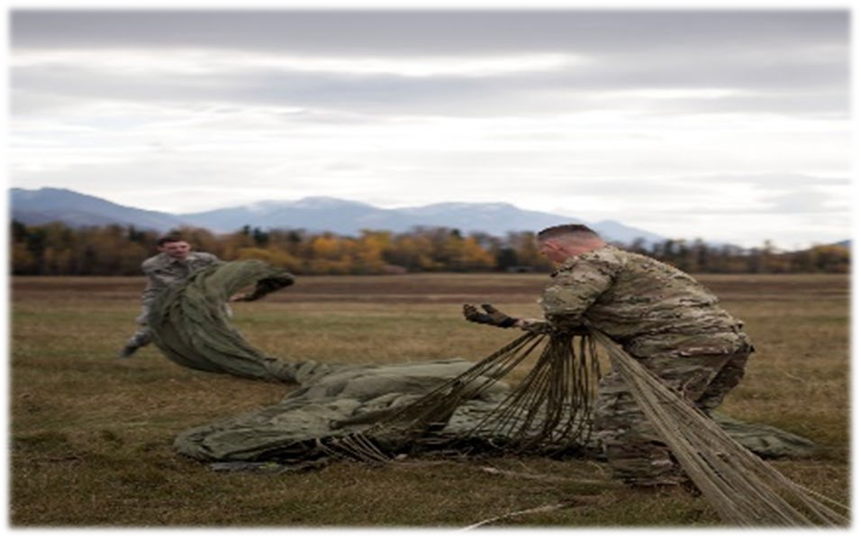


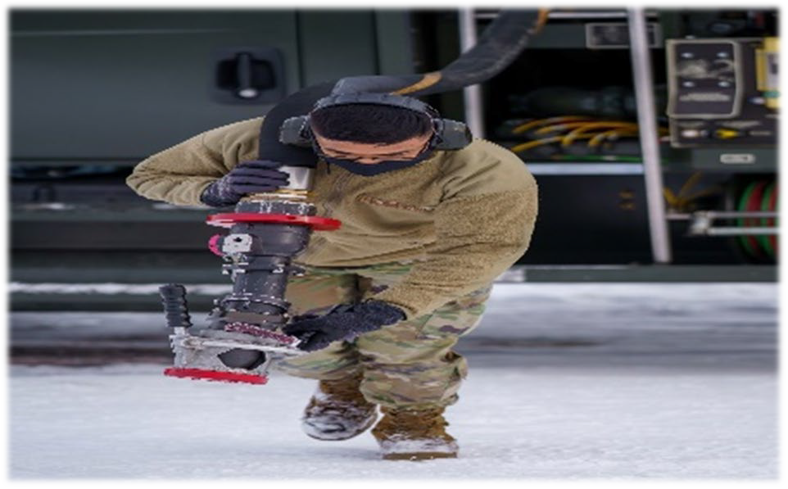
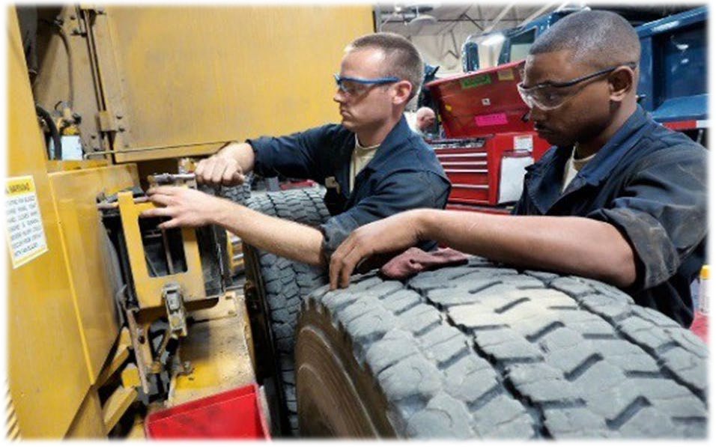
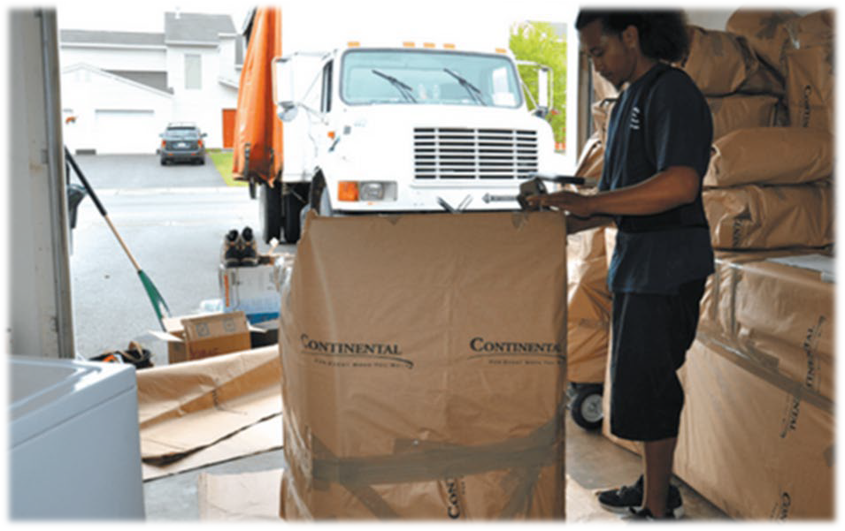
Logistics Readiness Group
Army Central Issue Facility
Household Goods/POVs
Deployment Operations (Joint Mobility Center)
Combat Mobility Operations
Air Force Materiel Management
Refueling & PoL Safety
Vehicle Management (TMP Yard)
Ground Transportation (Busses and Box Trucks)
Material Management
Refueling Operations
Vehicle Management
Household Goods
Agile Arctic Combat Support

Slide 9
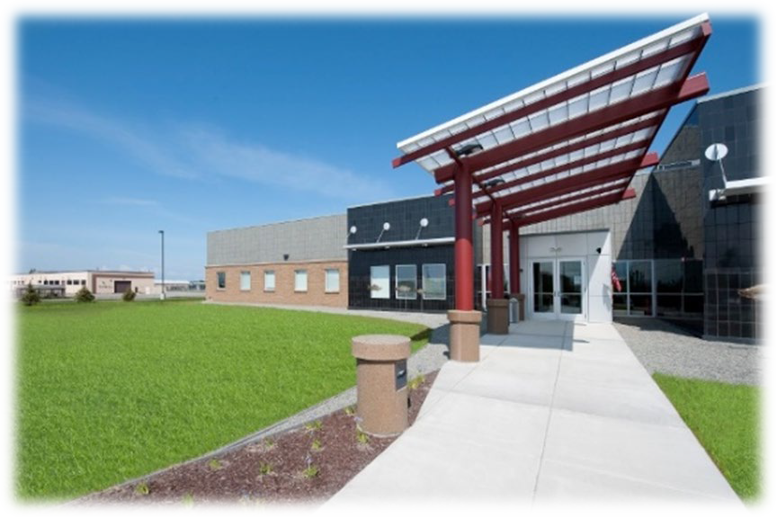
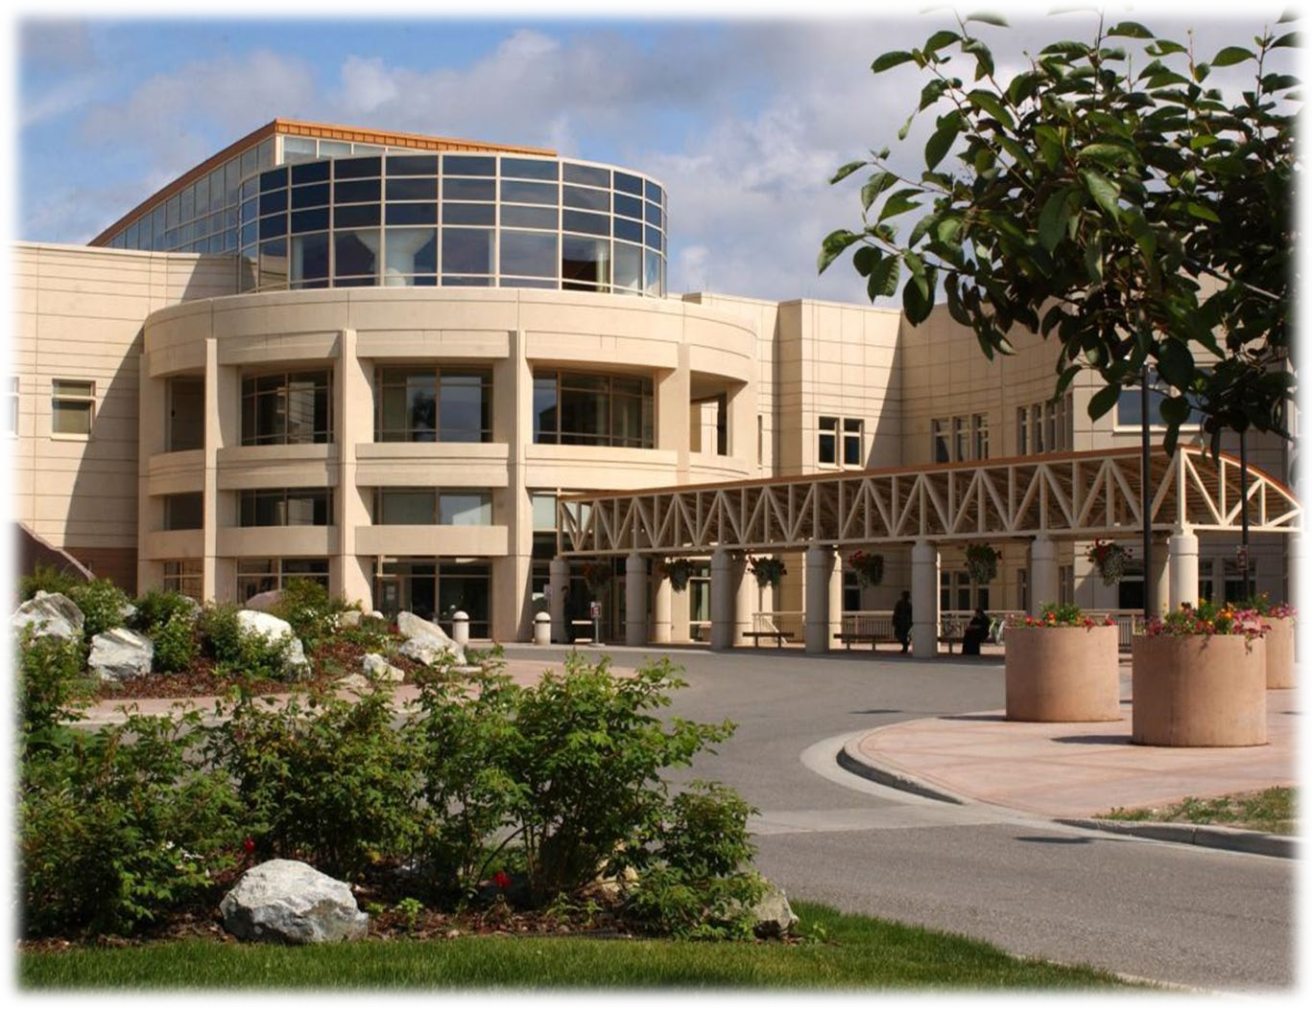
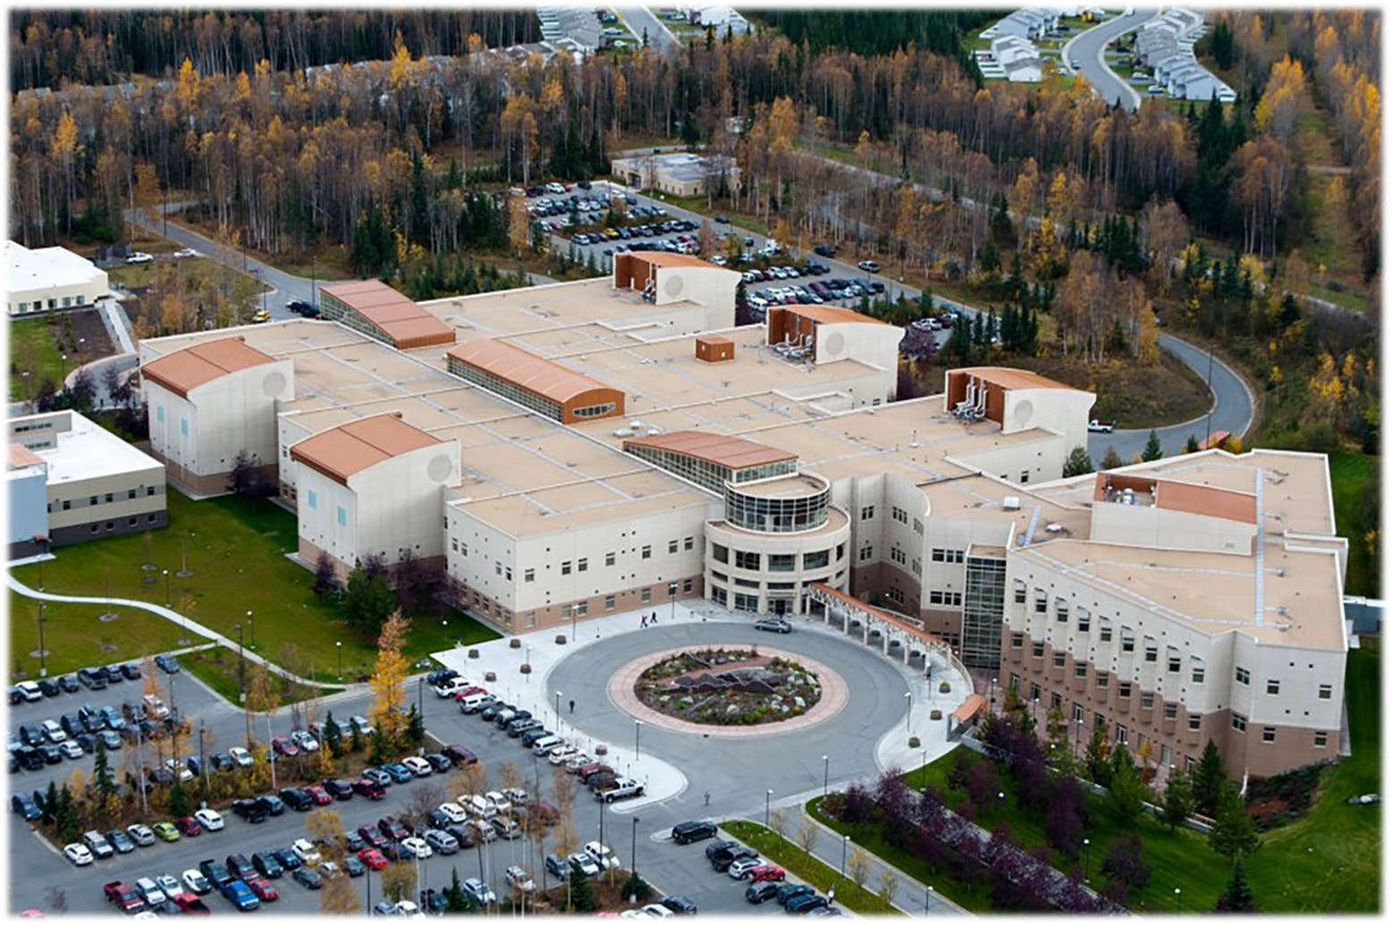





Medical Group
Medical Care
  Joint Venture with VA
  Soldier Care Medical Home (Troop Medical Clinic) - Active Duty Army
  JBER Hospital – DoD and Military Families
Agile Arctic Combat Support

Slide 10
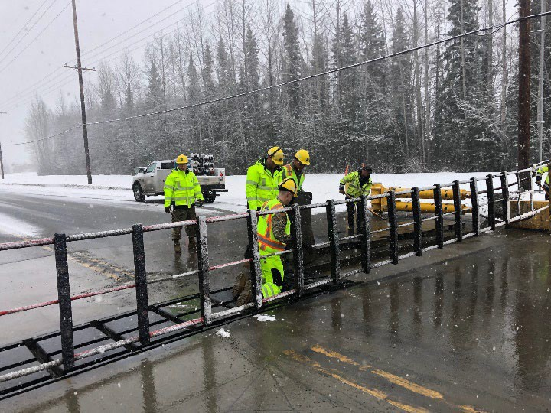
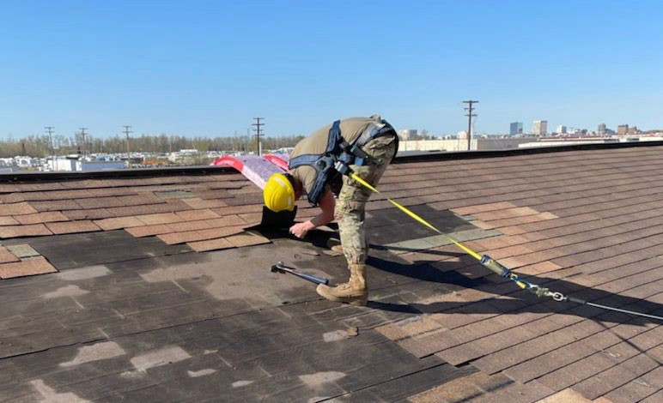

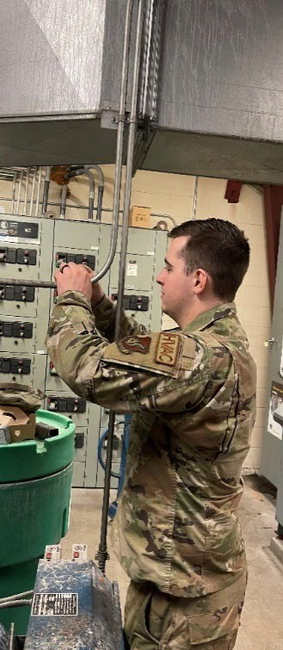
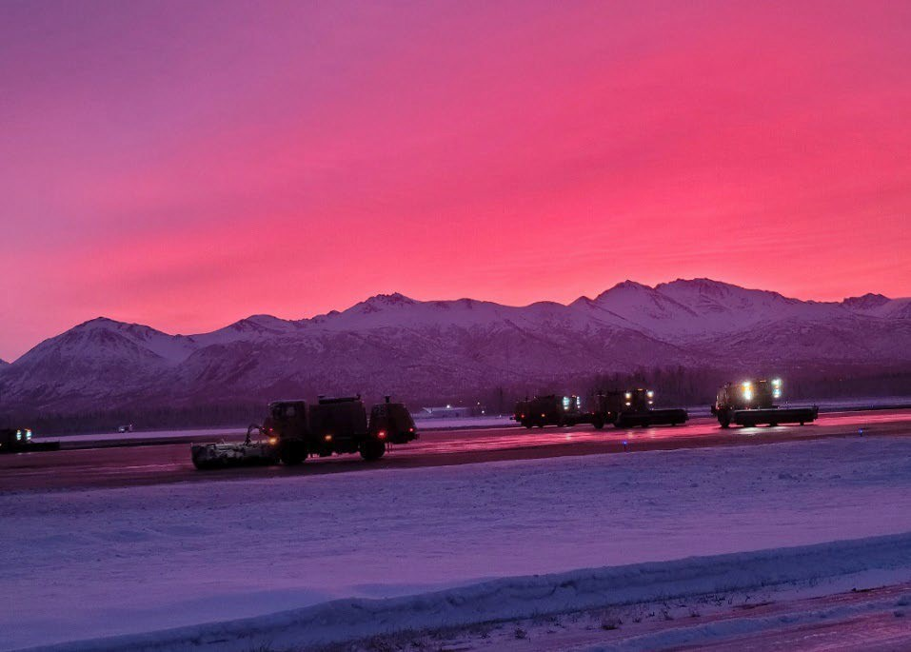
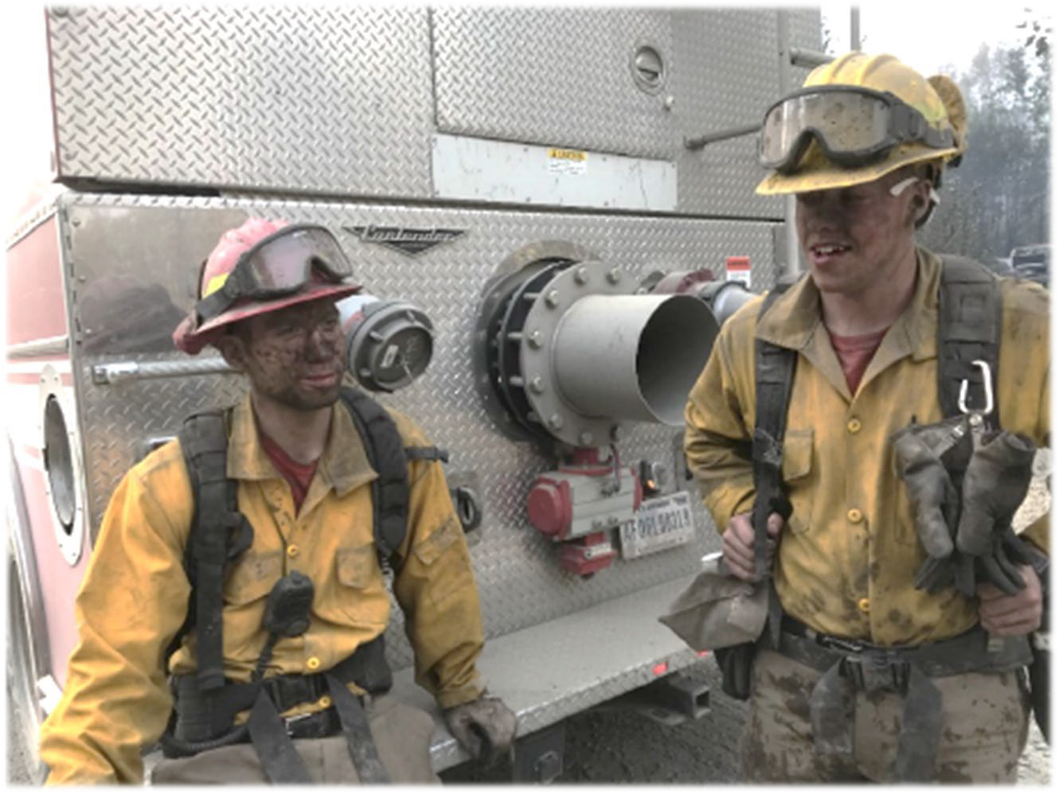
Civil Engineer Group
Engineering
  Airfield/Road Repairs
    Airfield Expansion
  Heat/Water/Electricity
  Firefighting/EOD/EM
  Housing/Barracks/Dorms
Agile Arctic Combat Support

Slide 11


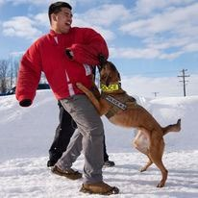
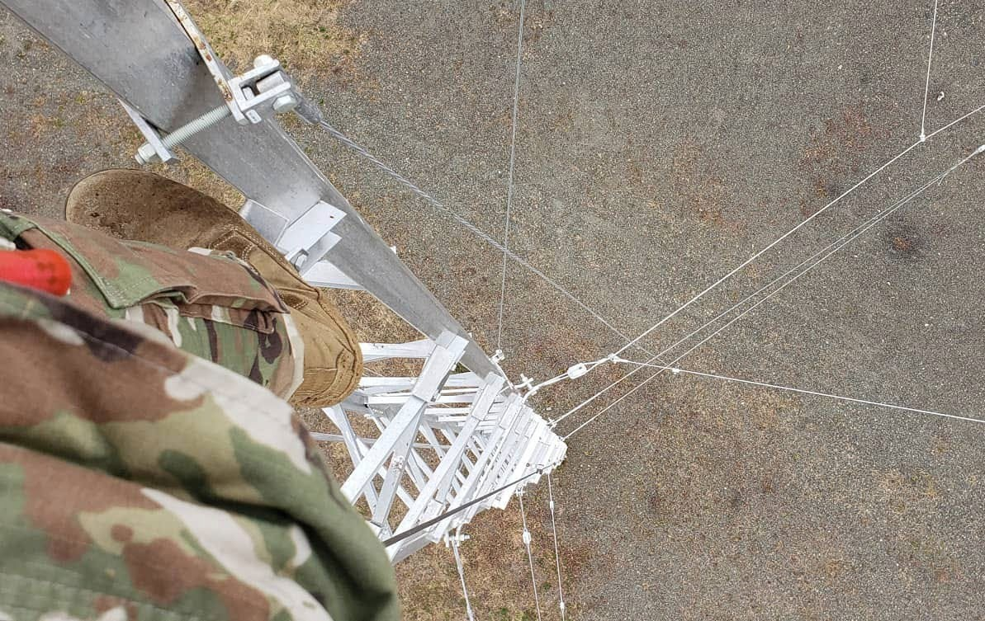
Mission Support Group
Mission Support
  Installation Security/Law Enforcement
  IT/Cyber Operations
  Contracting/Procurement
  Military Personnel Programs
  Dining Facilities
  Fitness Centers
  Lodging
  Child and Youth Programs
  Morale, Welfare, and Recreation Programs
Agile Arctic Combat Support

Slide 12



Emphasis Items
Nefarious, Unethical, Immoral, Illegal Behavior
  Protect yourself: Use the Wingman / Ranger/ Battle Buddy system
  Off-Limit Areas: Temporary Ban for all Service Members on the Gaslight Lounge with a permanent ban being brought forward to the Armed Forces Disciplinary Meeting
Cost of Living Allowance (COLA)
  Don’t Plan COLA or BAH into your long-term budget (you will move again)
Enjoy Alaska! …know your experience level
  Be prepared for all weather and all conditions
  Road Conditions:
Green: Roads are clear and dry. Drivers will comply with normal vehicle operating procedures andposted speed limits. Motorcycles may operate on JBER.
Amber: It has been determined that roads may be slippery due to snow, ice, or reduced visibility. Drivers will exercise caution. Motorcycles may NOT operate on JBER.
Red: It has been determined that roads may be hazardous due to snow, ice, or reduced visibility. Drivers will exercise caution and reduce speeds by 10 miles per hour below the posted speed limit.
Black: It has been determined that road conditions are extremely hazardous due to ice, snow, or reduced visibility. Vehicle dispatching is prohibited unless directed by command authority. Only operate mission-essential and emergency response vehicles. Drivers will exercise extreme caution and reduce speeds by 10 miles per hour below the posted speed limit.
Agile Arctic Combat Support

Slide 13
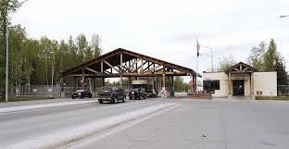
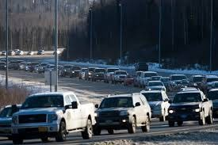
Base Security
JBER Security Priorities
  Airfield
  F22 Hangars
  Early Warning Systems
  Arms Rooms and SCIFs
  Base Access Points
Types of Security Lockdowns
  Stop, Check and Pass: Slows the exit and entrance of traffic at all gates. Initiated when there is a description of a subject or there is a lost/missing child. BOLOs, assaults, and an active shooter scenario are also reasons for stop, check, and pass
  Emergency Lock Down: Complete stop of all entry and exits at all gates. Most commonly triggered by an Arms Room or SCIF vault alarm.
No Trusted Traveler Policy
  All visitors that are not DOD dependents must check in and receive a pass at the Visitors Center at either Boniface or Richardson Gates.
No Drones!
  All use of drones is banned on the installation

Slide 14

Exploring Alaska
Current a/o: 4 FEB 26
BETTER OPPORTUNITY FOR SINGLE SERVICE MEMBERS
Available to Single Service Members, Geo-Bachelors, and Single parents.
Provides low to no cost events for JBER Service Members.
Focuses on assisting Service Members building connections within their community, personal growth, and morale activities.
Rec & Leisure – Fun events for low to no cost that boost morale for Service Members.
Community Service - Service Members get involved into the local community and earn volunteer hours.
Life Skills - Classes that teach, certify or license the Service Member.
Quality of Life – Events held to boost morale and assist with Installation issues.
Sign up for events through JBER BOSS Linktree online or scan the QR code on our flyers and calendars.
Contact Information
BOSS Phone - (907)406-4405
SPC Jackson, Destinee (President) destinee.t.jackson.mil@army.mil
SGT Johnson, David (VP) david.a.johnson1329.mil@army.mil
JBER BOSS Linktree

Slide 15
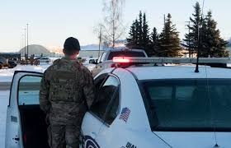
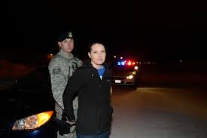
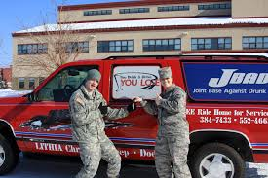
Joint Base Against Drunk Driving (JBADD)
Joint Base Against Drunk Driving (JBADD):
  Volunteer Organization that offers FREE rides home to Service Members, Veterans, DOW Civilians and dependents. All that is needed is that a member of the party requesting a ride has a DODID Card.
  Call 907-384-7433 for a free ride home!
  JBADD can also schedule pickups for unit social events. (Two Week minimum notice is required).
Agile Arctic Combat Support

Slide 16


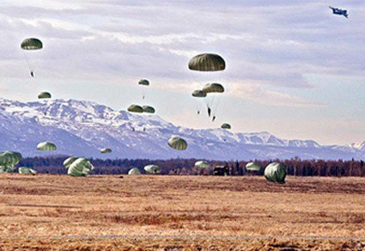
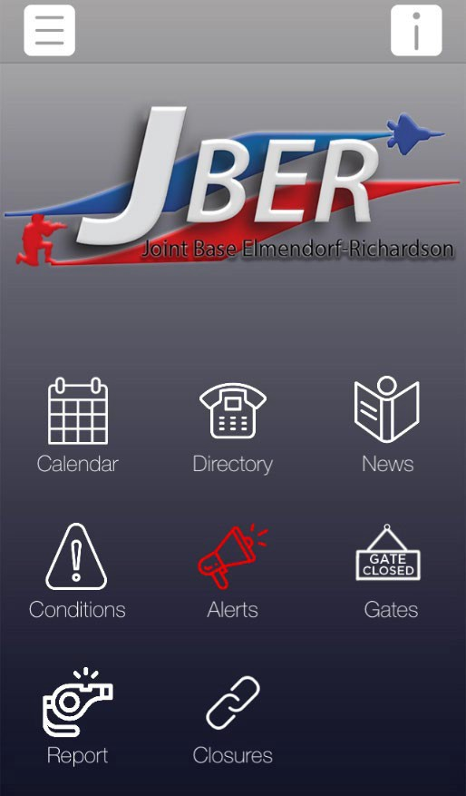
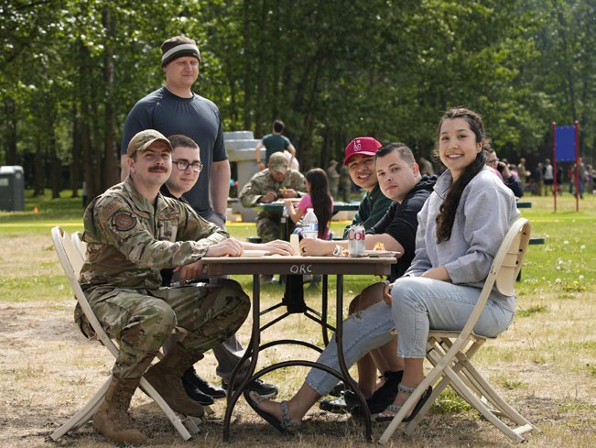
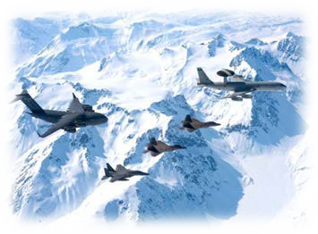
How We Communicate
JBER Connect App
JBER Website Link
  http://www.jber.jb.mil
JBER Facebook Link
  https://www.facebook.com/JBERAK
Emergency Mass Notification system (AtHoc)
  See your unit POC to sign up
Interactive Customer Evaluation (ICE)
  http://ice.disa.mil/index.cfm?fa=site&site_id=982
Agile Arctic Combat Support

Slide 17
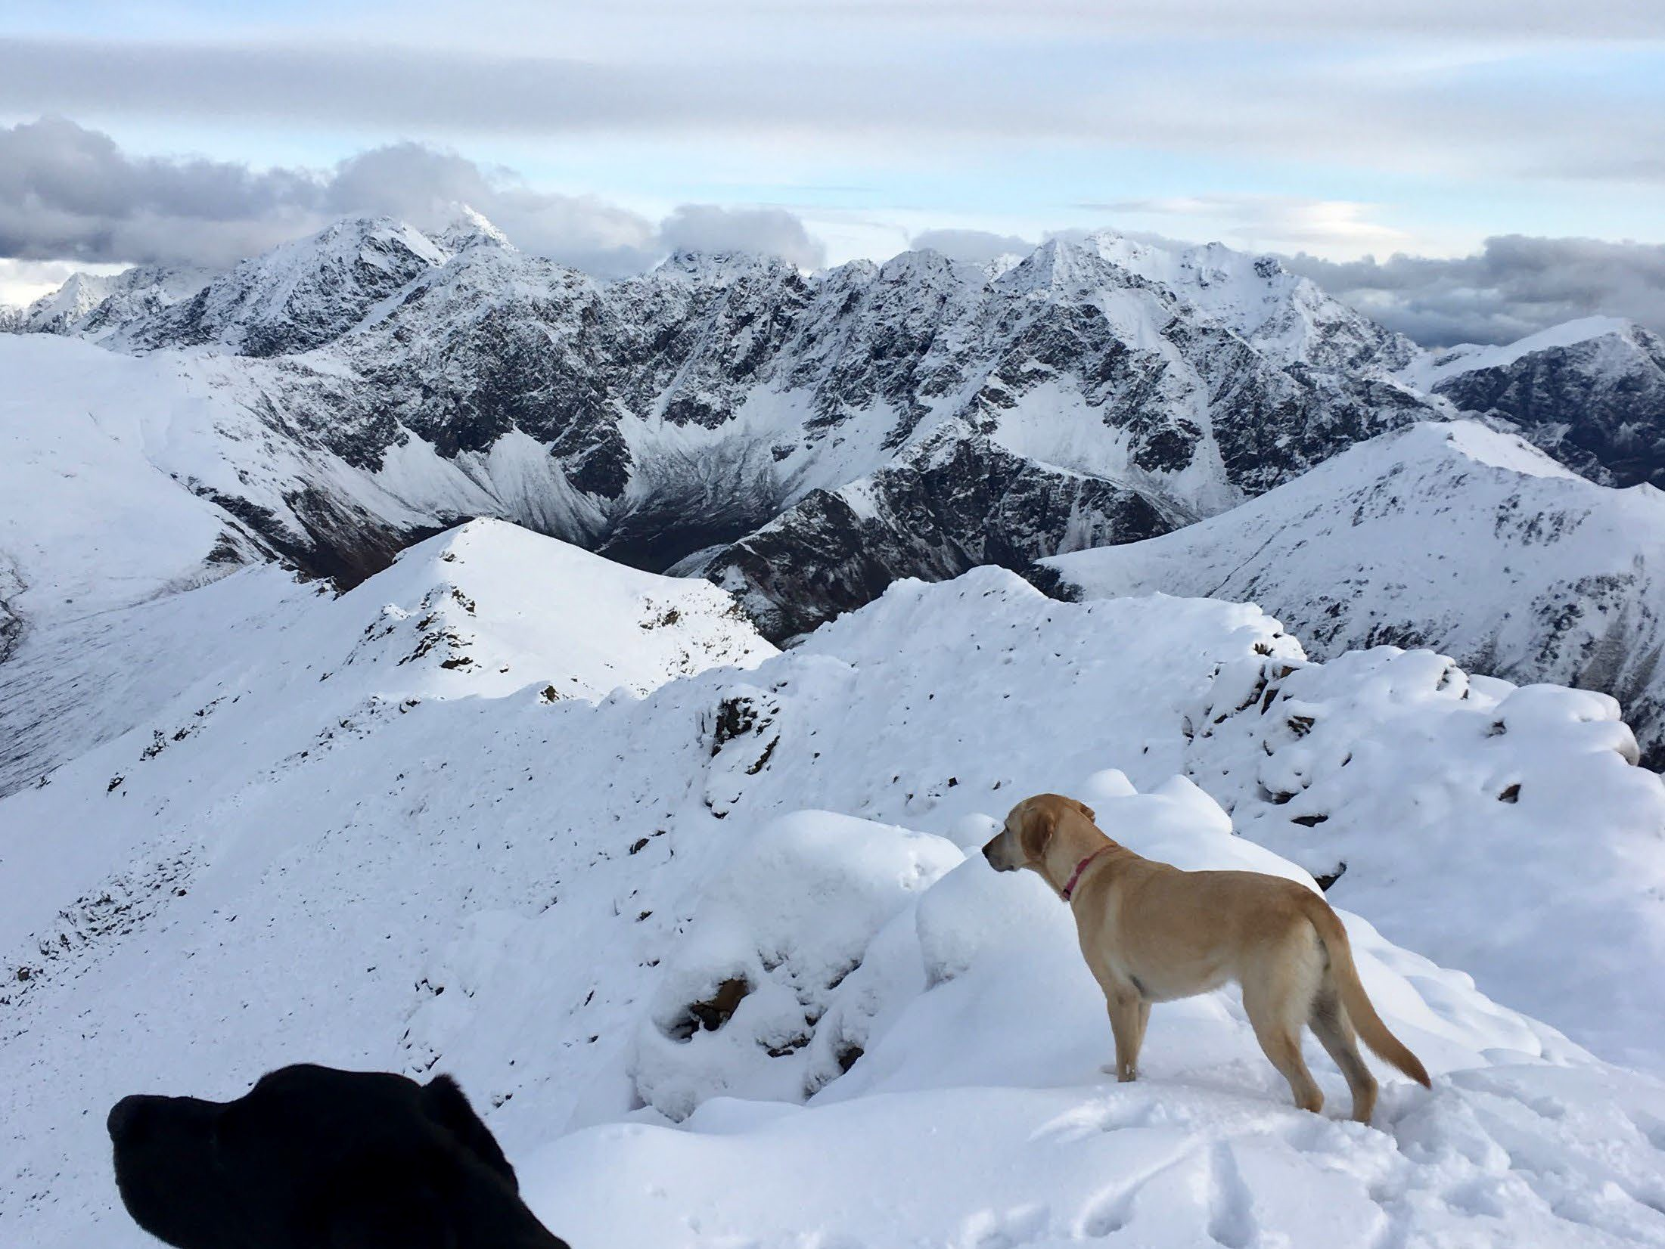
Questions
Agile Arctic Combat Support

